Slide 1










IEEE 1st International Conference on Electrical, Electronics and Computer Science with Advanced Power Technologies – A Future Trend (ICE2CPT 2025)
29st -31th Oct. 2025
Paper ID: 147
Title: Comparative Study of Encryption Algorithms in Client-Server Communication using Baudot Encoding
Names of Authors
Yelipe Gowtham
Paramkusam Sriharsha
Geda Tejesh Chowdary
Sreerag G
Kumaran U
Presented
by
Yelipe Gowtham
TECHNICAL AND FINANCIAL PARTNERS

Slide 2
Contents
Abstract
Introduction
Literature Review Summary
System Architecture Diagram
Methodology
Results and Analysis
Conclusion and Future Work
References

Slide 3
Abstract
Proposed a triple-layer encryption system combining:
Modified Caesar Cipher
Baudot Encoding
AES, 3DES, and Blowfish algorithms
Evaluated on a client–server model with varying file sizes.
Metrics analyzed: Encryption time, Decryption time, and Avalanche effect.
Aims to identify the most secure and efficient encryption technique for practical use.

Slide 4
Introduction
Growing network expansion increases exposure to cybersecurity risks.
Encryption ensures confidentiality, integrity, and data authenticity.
This research introduces a hybrid multi-layer encryption approach integrating classic and modern cryptographic methods.
Evaluates performance in real-time client-server communication.
Key contributions:
Comparative evaluation of AES, 3DES, Blowfish with Caesar + Baudot layers.
Performance assessment based on timing and security parameters.

Slide 5
Literature Review Summary
Prior works compared AES, DES, Blowfish, RSA, Twofish in terms of speed, memory, and security.
AES found fastest and highly secure; 3DES secure but slower; Blowfish efficient for low-memory systems.
Several studies proposed hybrid cryptography combining symmetric and asymmetric systems (e.g., AES + RSA).
Research gap: Few works explored combining classic encoding (Baudot) with modern encryption for layered protection.

Slide 6
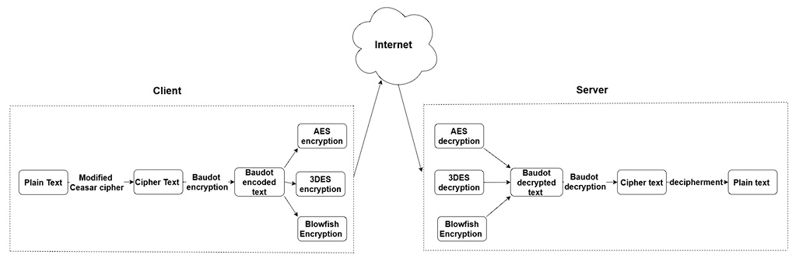
System Architecture Diagram

Slide 7
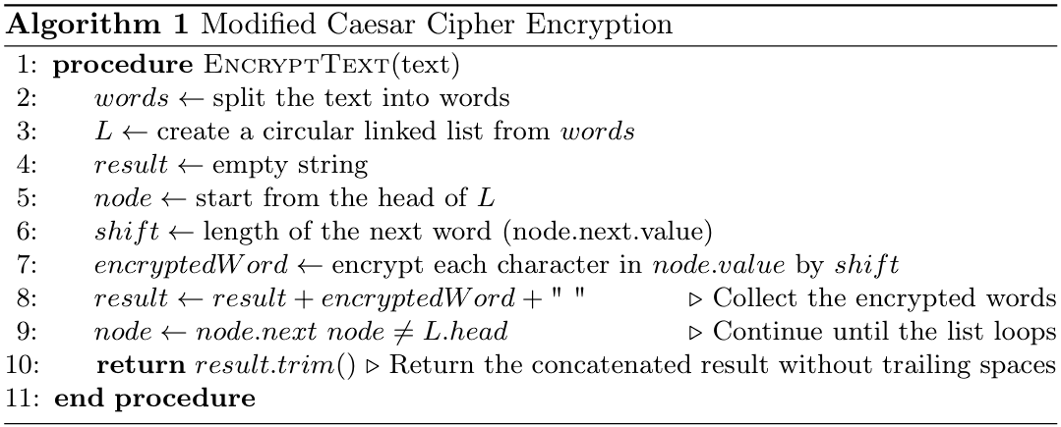
Methodology
Modified Caesar Cipher Algorithm
Here in the give algorithm Caesar cipher, a traditional method of encrypting data is used but with a circular linked list to decide the shift value also on the count of adjacent words in the sentence plan.
This modification added on to the classic cipher further employs variable shifts for each apart of the word thereby making it even more secure.
The first step is to create a circular linked list of the words which constitute the input sentence; the value in each node is the word’s length.
This setup means that each of the words will be shifted using a number each of which will be the length of the next word in the sequence.
If the string contains only one word, the shift value is equal to half the size of that word– this is a default shift value but variable so as to give the basic and variable level of encryption. This is shown in Algorithm 1.

Slide 8
Modified Caesar Cipher Example
The algorithm is explained with the help of an example sentence: “He is good boy.”
Here, all the words are arranged in circular linked list where the pointer of the first word is linked to the next node.
Since it has kind of circular linked list, that is why the last word of the sentence leads one again to the first word.
For encrypting the word “He”, length of the next word “is” will given as the key shift.
This continues until entire sentence has been encrypted, of which the encrypted cipher text is ‘Jg mw jrrg dqa.’
In the case when the input contains only one word, the key shift value is therefore the half of the length of that word.
For instance, to encrypt the word “Crime”, which has a length of 5, the floor division operator computes the key shift as 2 (5//2), and the encrypted cipher text for the word is “Etkog”.

Slide 9
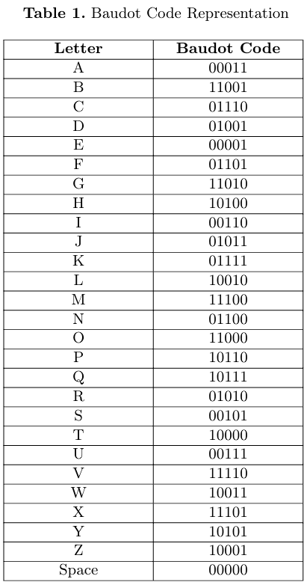
Baudot Code
The Baudot code is a 5-bit character set used at first in telegraphy data transmission.
In this project the Baudot code is used to put Caesar cipher’s output into standardized format to encrypt the text through modern algorithms like AES, 3DES or Blowfish.
This encoding helps to convert texts to bits, which is a very important segment in the process of encryption.
The plain text “Crime” is encrypted to “Etkog” using Modified Caesar cipher as discussed previously.
This cipher text is then encoded into Baudot code as “0000110000011111100011010” taken from the Table 1 for secure transmission.

Slide 10
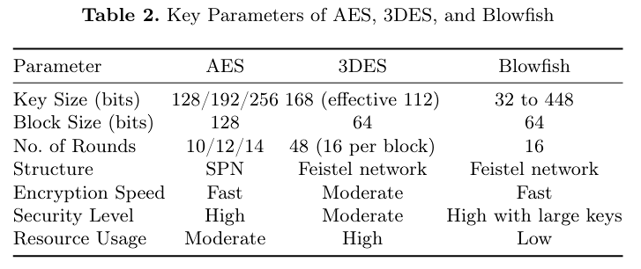
Encryption Algorithms
AES (Advanced Encryption Standard)
AES is a symmetric block cipher specific for its speed and security; that works in 128, 192 or 256 bit block that makes it resistant to numerous attacks.
It is used in a large number of security variant protocols such as SSL/TLS of Internet security due to its high efficiency of operating in both hardware and software.
3DES (Triple Data Encryption Standard)
3DES improves DES in the ability to encrypt data, by doing so, three times.
While being significantly slower than AES because of its triple encryption algorithm, 3DES is still in use where compatibility with legacy standards is of uttermost importance and where data security is needed.
Blowfish
Blowfish is a flexible symmetric block cipher suitable for hardware and software environments that show good performance.
It employs variable length keys thus suitable for application which need high speed of encryption without much affecting the security feature due to the weakness of the cipher to modern attacks.

Slide 11
Metrics Evaluation
In the present comparative study of the encryption algorithms, the following quantitative parameters are employed to analyze their performance and security merits.
Metrics include encryption and decryption rates as they denote the amount of time taken by the algorithms in transforming and restoring the data and offers a detailed insights of performance and speed.
Further, the evaluation is carried to measure the avalanche effect, which defines the percentage of encrypted output changing due to the slight variation of the input data, ensuring the algorithm’s safety against various attacks.
Memory utilization is also monitored to assess the resource consumption of each algorithm useful in the deployment of functions in resource-constrained settings.
These metrics collectively provide an overview of each algorithm, what it can do best and what it cannot do well.

Slide 12
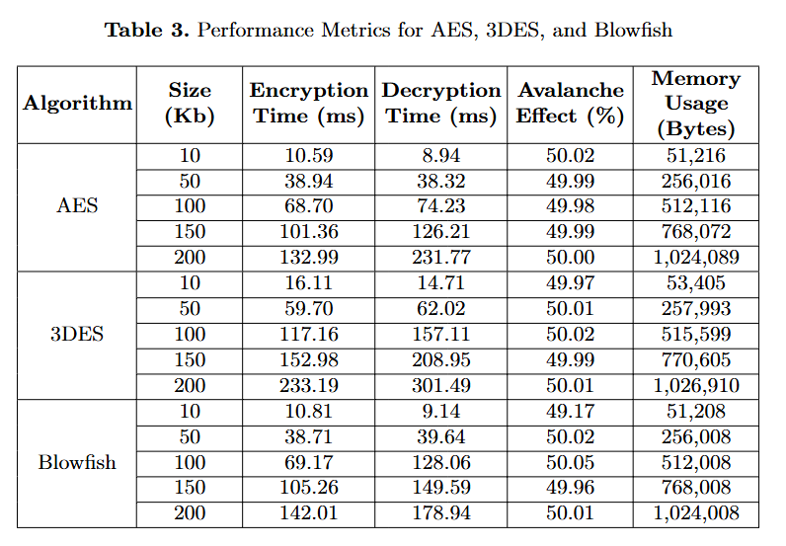
Results and Analysis
The Avalanche Effect obtained for the AES, 3DES, and Blowfish encryption algorithms reveals the effectiveness of these methods within cryptographic safety.
This effect measures how much a vast change in the output, due to a slight shift in the input of just one bit, will guarantee the ciphertext is very sensitive to the plaintext.
Every learnt method depicted an avalanche characteristic in proximity with the benchmark of 50 implying that altering an input bit alters half of the output bits on average.
This high amount of unpredictability is important to secure encryption because it means that an attacker can’t make assumptions about the plaintext or the encryption key.
For Memory Usage, AES provides higher encryption strength, it consumes more memory resources at bigger data volumes, potentially affecting performance in resource-constrained applications.
Blowfish, on the other hand, is a more memory-efficient choice, especially for applications with strict memory limits.
This analysis emphasizes the relevance of choosing encryption methods based on resource availability and security requirements

Slide 13
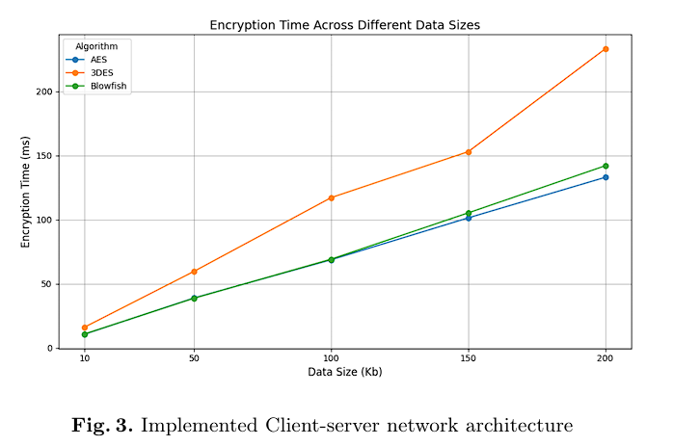
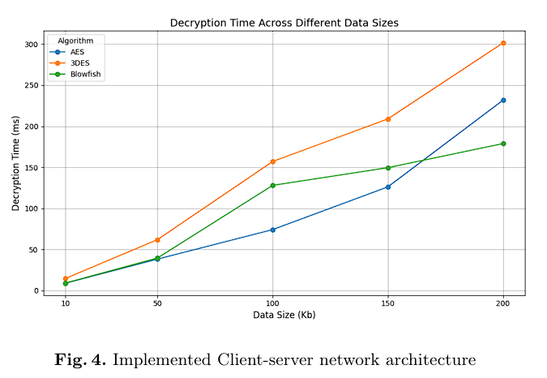

Slide 14
Conclusion and Future work
Developed a triple-layer hybrid encryption system
Integrated Modified Caesar Cipher + Baudot Encoding + Modern Cryptography
AES outperformed 3DES and Blowfish in all key metrics
Blowfish best suited for memory-limited systems
3DES remains highly secure but slow
Conclusion: AES + Baudot layer gives best trade-off of speed & security
Future Enhancements:
Integrate Post-Quantum Cryptography
Add AI-based adaptive encryption selection
Extend model to IoT and Cloud systems for scalability

Slide 15
References
Patel, K. Performance analysis of AES, DES and Blowfish cryptographic algorithms on small and large data files. Int. j. inf. tecnol. 11, 813–819 (2019). doi:10.1007/s41870-018-0271-4
Alenezi, M. N., Alabdulrazzaq, H. K., & Mohammad, N. Q. (2022). Symmetric Encryption Algorithms: Review and Evaluation Study. International Journal of Communication Networks and Information Security (IJCNIS), 12(2). doi:10.17762/ijcnis.v12i2.4698 .
Q. Zhang, "An Overview and Analysis of Hybrid Encryption: The Combination of Symmetric Encryption and Asymmetric Encryption," 2021 2nd International Conference on Computing and Data Science (CDS), Stanford, CA, USA, 2021, pp. 616-622, doi: 10.1109/CDS52072.2021.00111.
S. Kumar, B. K. Singh, Akshita, S. Pundir, S. Batra and R. Joshi, "A survey on Symmetric and Asymmetric Key based Image Encryption," 2nd International Conference on Data, Engineering and Applications (IDEA), Bhopal, India, 2020, pp. 1-5, doi: 10.1109/IDEA49133.2020.9170703.
V. Verma, P. Kumar, R. K. Verma and S. Priya, "A Novel Approach for Security in Cloud Data Storage Using AES-DES-RSA Hybrid Cryptography," 2021 Emerging Trends in Industry 4.0 (ETI 4.0), Raigarh, India, 2021, pp. 1-6, doi: 10.1109/ETI4.051663.2021.9619274.
A. Serdano, M. Zarlis and E. B. Nababan, "Performance of Combining Hill Cipher Algorithm and Caesar Cipher Algorithm in Text Security," 2021 International Conference on Artificial Intelligence and Mechatronics Systems (AIMS), Bandung, Indonesia, 2021, pp. 1-5, doi: 10.1109/AIMS52415.2021.9466039.
S. A. M. Rizvi, S. Z. Hussain and N. Wadhwa, "Performance Analysis of AES and TwoFish Encryption Schemes," 2011 International Conference on Communication Systems and Network Technologies, Katra, India, 2011, pp. 76-79, doi: 10.1109/CSNT.2011.160.
E. Jintcharadze and M. Iavich, "Hybrid Implementation of Twofish, AES, ElGamal and RSA Cryptosystems," 2020 IEEE East-West Design & Test Symposium (EWDTS), Varna, Bulgaria, 2020, pp. 1-5, doi: 10.1109/EWDTS50664.2020.9224901.
M. B. Yassein, S. Aljawarneh, E. Qawasmeh, W. Mardini and Y. Khamayseh, "Comprehensive study of symmetric key and asymmetric key encryption algorithms," 2017 International Conference on Engineering and Technology (ICET), Antalya, Turkey, 2017, pp. 1-7, doi: 10.1109/ICEngTechnol.2017.8308215.
S. Tang and F. Liu, "A one-time pad encryption algorithm based on one-way hash and conventional block cipher," 2012 2nd International Conference on Consumer Electronics, Communications and Networks (CECNet), Yichang, China, 2012, pp. 72-74, doi: 10.1109/CECNet.2012.6201917.
Priyadarshini Patil, Prashant Narayankar, Narayan D.G., Meena S.M., "A Comprehensive Evaluation of Cryptographic Algorithms: DES, 3DES, AES, RSA and Blowfish" Procedia Computer Science, Volume 78, 2016, Pages 617-624, ISSN 1877-0509, doi: 10.1016/j.procs.2016.02.108.

Slide 16
Chaudhary, Rajat et al. “A Security Solution for the Transmission of Confidential Data and Efficient File Authentication Based on DES, AES, DSS and RSA.” (2012).
P. Semwal and M. K. Sharma, "Comparative study of different cryptographic algorithms for data security in cloud computing," 2017 3rd International Conference on Advances in Computing,Communication & Automation (ICACCA) (Fall), Dehradun, India, 2017, pp. 1-7, doi: 10.1109/ICACCAF.2017.8344738.
N. J. R, R. Patil, O. Sawant, S. Madasamy and S. R, "AES Algorithm with Dynamic Shift Rows and Bit Permuted Mix Column," 2023 International Conference on Next Generation Electronics (NEleX), Vellore, India, 2023, pp. 1-6, doi: 10.1109/NEleX59773.2023.10421625.
S. Routray, D. Raipure, S. R. Nayak K and N. P. Shetty, "Secure Sharing of Text Based Data Using Hybrid Encryption Algorithms in a Client-Server Model," 2021 Fourth International Conference on Electrical, Computer and Communication Technologies (ICECCT), Erode, India, 2021, pp. 1-7, doi: 10.1109/ICECCT52121.2021.9616671.
A. Kubadia, D. Idnani and Y. Jain, "Performance Evaluation of AES, ARC2, Blowfish, CAST and DES3 for Standalone Systems : Symmetric Keying Algorithms," 2019 3rd International Conference on Computing Methodologies and Communication (ICCMC), Erode, India, 2019, pp. 118-123, doi: 10.1109/ICCMC.2019.8819729.
H. Dibas and K. E. Sabri, "A comprehensive performance empirical study of the symmetric algorithms:AES, 3DES, Blowfish and Twofish," 2021 International Conference on Information Technology (ICIT), Amman, Jordan, 2021, pp. 344-349, doi: 10.1109/ICIT52682.2021.9491644.
R. Indrayani, Subektiningsih, P. Ferdiansyah and D. A. Satria, "Effectiveness comparison of the AES and 3DES cryptography methods on email text messages," 2019 International Conference on Information and Communications Technology (ICOIACT), Yogyakarta, Indonesia, 2019, pp. 66-69, doi: 10.1109/ICOIACT46704.2019.8938579.
N. Raheja and A. K. Manocha, "An Efficient Encryption-Authentication Scheme for Electrocardiogram Data using the 3DES and Water Cycle Optimization Algorithm," 2021 6th International Conference on Signal Processing, Computing and Control (ISPCC), Solan, India, 2021, pp. 10-14, doi: 10.1109/ISPCC53510.2021.9609415.
H. S. Deshpande, K. J. Karande and A. O. Mulani, "Efficient implementation of AES algorithm on FPGA," 2014 International Conference on Communication and Signal Processing, Melmaruvathur, India, 2014, pp. 1895-1899, doi: 10.1109/ICCSP.2014.6950174.

Slide 17
Thank You

